Slide 1
WELCOME
Educator Plenary Session
Cultivating Your Wellbeing:
Mindfulness Meditation & Authentic Communication
Cristy Clouse cristy@pbiscaltac.org Henri Maddocks henri@pbiscaltac.org
Notes:
Introductions
Cultivating you wellbeing is such a timely topic as most of us and the country have experiences some perceived loss of control, stress and anxiety in the last 8 months in the last 2 days. Focus on our own well-being is not selfish; we are all interdependent ; more than ever we need to be kind and forgiving of to ourselves, listen with empathy

Slide 2
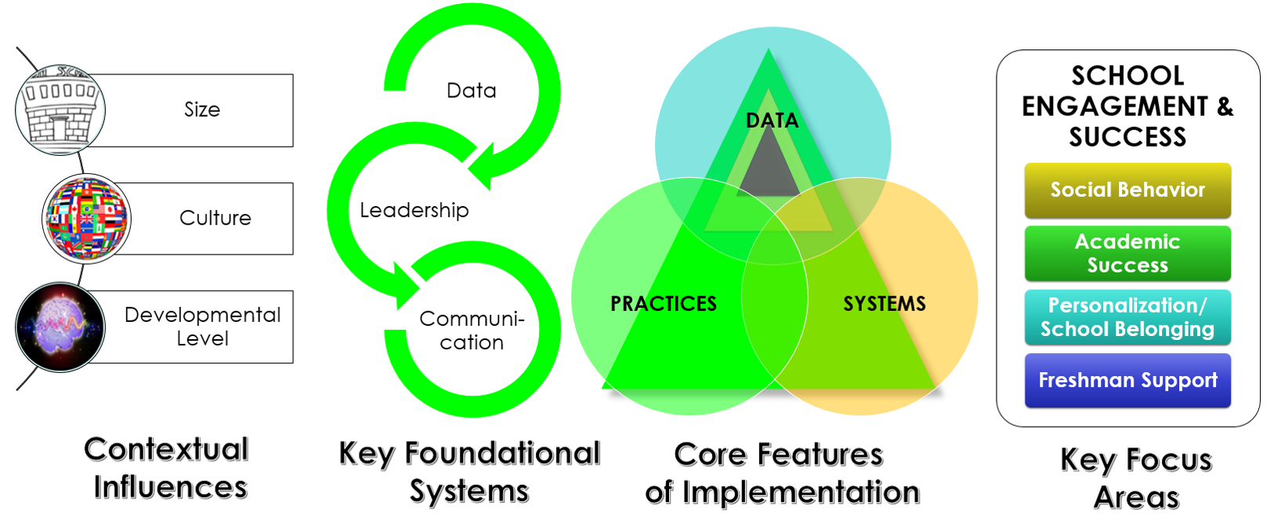
For Your Consideration
Flannery and Kato, 2012
Notes:
Considerations: Cultivating a Culture of Wellness we are also considering the contextual influences of high school, key foundational systems and of course the core features of implementation OSPD and finally key focus areas

Slide 3
REFLECT on “WHY”
you are part of high school reform
ENCOURAGE
coalescing around the topic
CELEBRATE
participation and involvement in the transformation
AUTHENTIC ENGAGEMENT
Notes:
We invite you to engage in the content and practice opportunity for cultivates your wellbeing

Slide 4
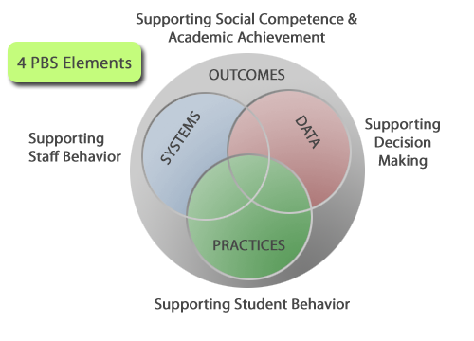
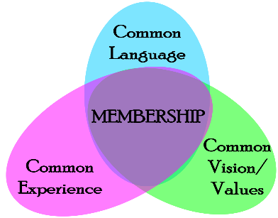
Adult Wellness Brief
Center on PBIS www.pbis.org
MTSS ADULT WELLNESS
https://www.pbis.org/video/session-a3-pbis-forum-2020-multi-tiered-systems-to-support-adult-wellness
Multi-Tiered Systems of Support
Normalizing a
Culture of Wellness
Notes:
Revisit the broad purpose of PBIS:
To improve the effectiveness, efficiency, and equity of schools AND organizations/agencies.
To improve social, emotional and academic outcomes for ALL students, including students with disabilities and students with disabilities and students from underrepresented groups
Normalizing a Culture of Wellness
Multi-tiered Systems of Support (Link to Presentation)
The Center for PBIS is repacking the MTSS Framework to include a culture or organization of wellness
This of course requires shifts at the district/building/classroom level and it will take a village
Adult Wellness Brief (National TA Center on PBIS)
In the meantime we all have the responsibility to take care of ourselves so we can take care of others

Slide 5
RESEARCH
STAFF WELLNESS
Schools that prioritize staff wellness demonstrate positive staff interactions, a shared commitment to student success, and an increased sense of warmth. (Bradshaw, et al., 2008)
Teachers who experience occupational stress tend to demonstrate a lack of emotional support and negative interactions with students, producing additional stress for
at-risk students (Hamre, & Pianta, 2005; Oberle & Schonert Reichl, 2016).
Notes:
What does the research say?
Schools that prioritize staff wellness demonstrate
positive staff interactions,
a shared commitment to student success, and
an increased sense of warmth. Catherine and collegues at UVA(Bradshaw, et al., 2008)
However, teachers who experience occupational stress tend to demonstrate
a lack of emotional support and
negative interactions with students, producing additional stress for at-risk students (Hamre, & Pianta, 2005; Oberle & Schonert Reichl, 2016).
Hard to start co-regulating with students

Slide 6
www.stress.org
Notes:
Stress in the Workplace www, stress.org (The American Institute of Stress)
Highly personalized phenomenon
Severity of job stress depends on the magnitude of the demands that are being made and the individual’s sense of control or decision-making latitude he or she has in dealing with them
Scientific studies based on this model confirm that workers who perceive they are subjected to high demands but have little control are at increased risk for negative health implications
Stress in the Workplace www, stress.org (The American Institute of Stress)
Highly personalized phenomenon
Severity of job stress depends on the magnitude of the demands that are being made and the individual’s sense of control or decision-making latitude he or she has in dealing with them
Scientific studies based on this model confirm that workers who perceive they are subjected to high demands but have little control are at increased risk for negative health implications

Slide 8
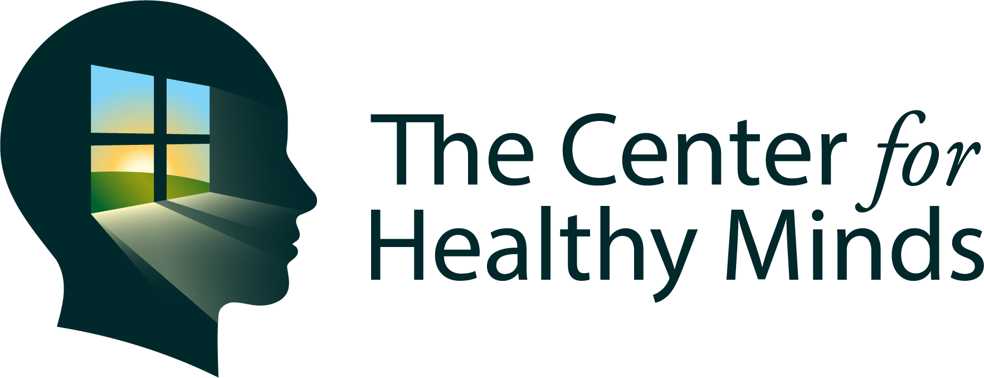
Cultivating Your Well Being
Four Pillars of a Healthy Mind
Dahl, C.J., Wilson-Mendenhall, C.D., and Davidson, R.J. (2020)
The Plasticity of Well-being: A Training-based Framework for the Cultivation of Human Flourishing.
awareness
connection
insight
purpose
Notes:
Center for Healthy Minds follows a scientific model of wellbeing following decades of research and centuries of wisdom oriented towards the simple idea that wellness is a skill, somethings we can train, practice and get better with…a set of skills that can be learned and cultivated over time, just like learning to play a musical instrument or riding a bike.
Train our minds and rewire our brains
Four Pillars of a Healthy Minds
The Center for Healthy Minds has created a new scientific framework for understanding how human flourishing can be nurtured consisting of four pillars of well-being: awareness, connection, insight, and purpose. Research shows that each of these four pillars are related to specific networks in the brain and can be strengthened through meditation and other forms of mental training
Healthy Minds Free APP
uses neuroscience, contemplative traditions, and skill-based learning methods to help you develop the skills for a healthy mind
Translate the neuroscience of wellbeing into practical tools that we can apply in everyday life
Henri/Awareness
In short, awareness is being fully connected to our present experience.
Awareness is the experience of being fully present and attuned to what is happening in the moment.
As opposed to being distracted or absorbed in an activity.
Mindfulness is the heighten state of awareness of what is going on in one’s environment, mind and body.
Attention and Self-Awareness supports us with noticing emotional triggers and self-regulation.
Cristy/Connection
Connections is about widening the circle of healthy, connected relationships.
The quality of our relationships impact the quality of our work.
Awareness of healthy relationships with people we care about and with people we may not even like or know,
Appreciation, Compassion and Authentic Communication are qualities and skill sets required for healthy connections.
Henri:
Insight
Insight is having a deep understanding of how our minds work.
This applies to our thoughts and emotions, and how our beliefs and expectations shape our experience.
Insight promotes enduring well-being by increasing resilience and prompting transformative realizations about the nature of the mind, relationships, and experience.
Cristy:
Purpose
Purpose is what motivates, inspires and drives us in life.
Cultivating a deep sense of purpose and meaning in life has been shown to have far reaching benefits, including to our physical and mental well-being.
“Think about what gives your life meaning. Do what makes you happy or makes you fulfilled, and make sure to save time for it. It may help you to start your day thinking about your purpose in life, or thinking about what gives your life meaning when trying to refocus after a stressful or unpleasant experience.”

Slide 9
Well at Work: Strategies From Research to the Real World
https://www.youtube.com/watch?v=pSFFWT7JbF4&feature=youtu.be&t=901
“Mindfulness and the space it provides allowed us to think differently about our words, practices and then put our practices into actions.”
“We get emotional and wrapped up in everything going on; there can be challenging conversations and emboding these qualities of taking a moment before responding to check-in with myself has been supportive”
“I am now mindful before I enter into Courageous Conversations; entering from a healthy or positive place will probably help to move the work forward”
“Mindfulness has blended perfectly with sharing space in restorative circles”
“Having the ability to refelct on our own implicit bias is greatly lifted up by mindfulness practices – pausing-breathing-grounding”
“Awareness Pillar made me aware of what we don’t know.”
“The practices themselves give us a stronger base in responding rather than reacting.”
“Compassion for ourselves, compassion for others and a mindful attitude of being nonjudgmental.”
awareness
connection
insight
purpose
Notes:
The Center has partners with Madison Wisconsin Metropolitan School District
Working with them to promote well-being these challenging times
“Mindfulness and the space it provides allowed us to think differently about our words, practices and then put our practices into actions”
“We get emotional and wrapped up in everything going on; there can be challenging conversations and emboding these qualities of taking a moment before responding to check-in with myself has been supportive”
“I now mindful before I enter into Courageous Conversations; have to enter from a healthy or positive place will probably help to move the work forward”
“Mindfulness has blended perfectly with sharing space in restorative circles”
“Having the ability to reffelct on our own implicit bias is greatly lifted up by minfulness practices – pausing-breathing-grounding”
“Awareness Pillar made me aware of what we don’t know.

Slide 10
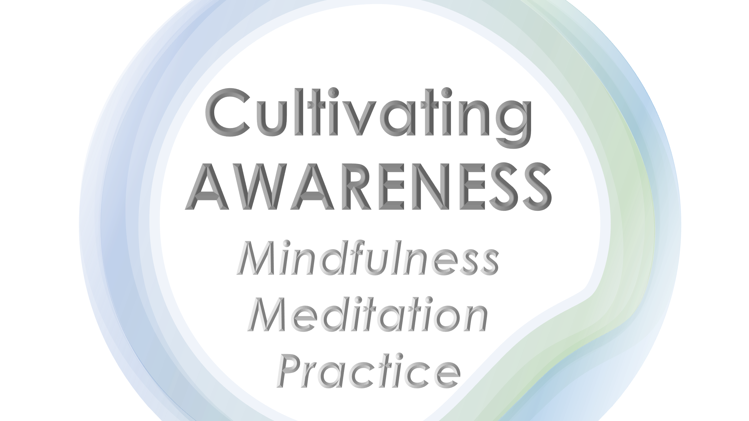

Slide 13
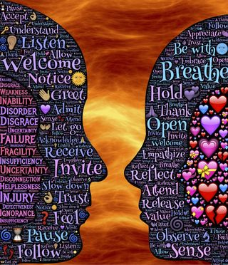
Cultivating CONNECTIONS
Authentic
Communication Practice
Notes:
Authentic and compassionate communication improves the quality of our relationships by
Deepening emotional connections
Transforming judgement and critism into understanding and compassion
Listening so others are really heard
Getting what you want more often without using demands, guilt or shame
Finding the heart of conflict and disputes quickly

Slide 14
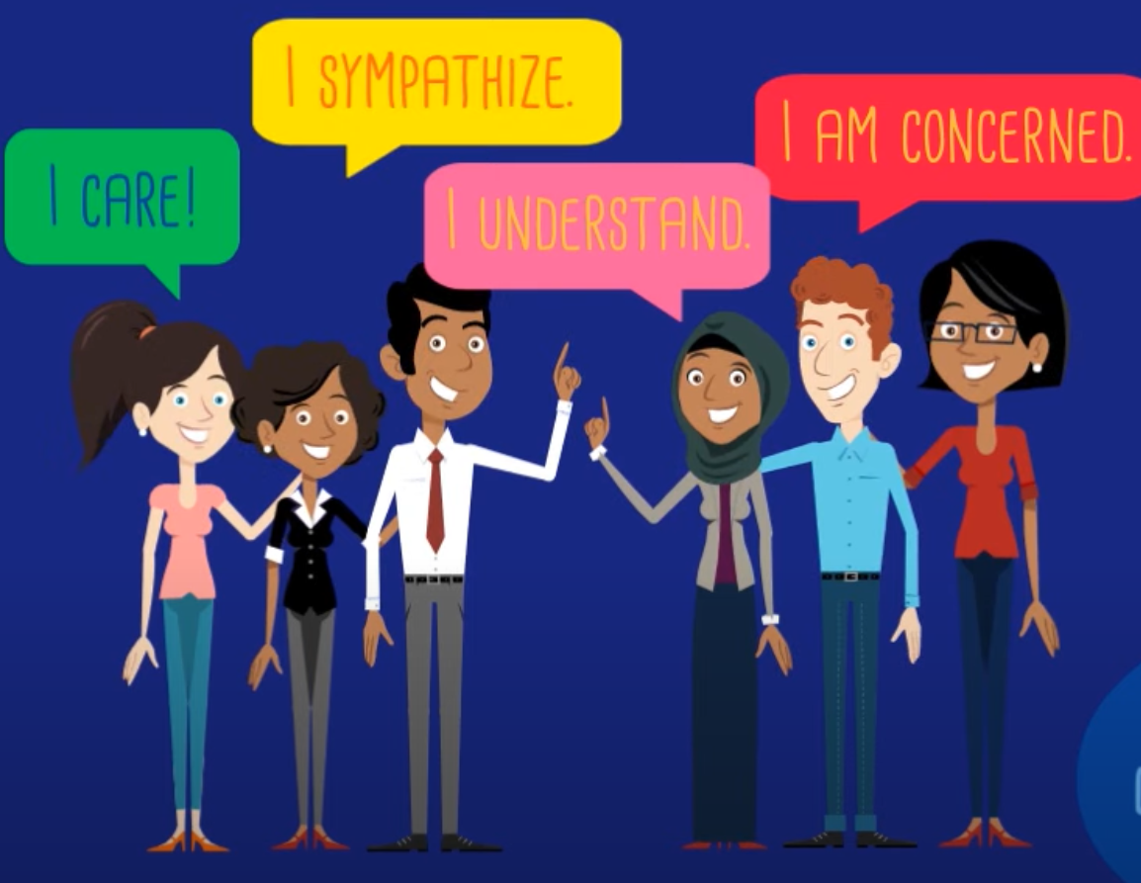
Marshall B. Rosenberg
Notes:
Using NVC techniques (Marshall B. Rosenberg
we learn to develop a vocabulary of feelings and needs that helps us more clearly express what is going on in us,
and understand feelings and needs that helps us more clearly express what is going in others, at any given moment.
When we understand and acknowledge our needs, we develop a shared foundation for much more satisfying relationships.
OBSERVATION/FEELINGS/NEEDS/REQUESTS
We all have the compensity to be compassionate;
We need to sometimes be aware of communications or actions that might be unintentionally hurtful.
When we don’t have a more effective way to communicate, to get our needs met,
We lash out, we judge, we might blame or use guilt in an effort to try and get our needs met

Slide 15
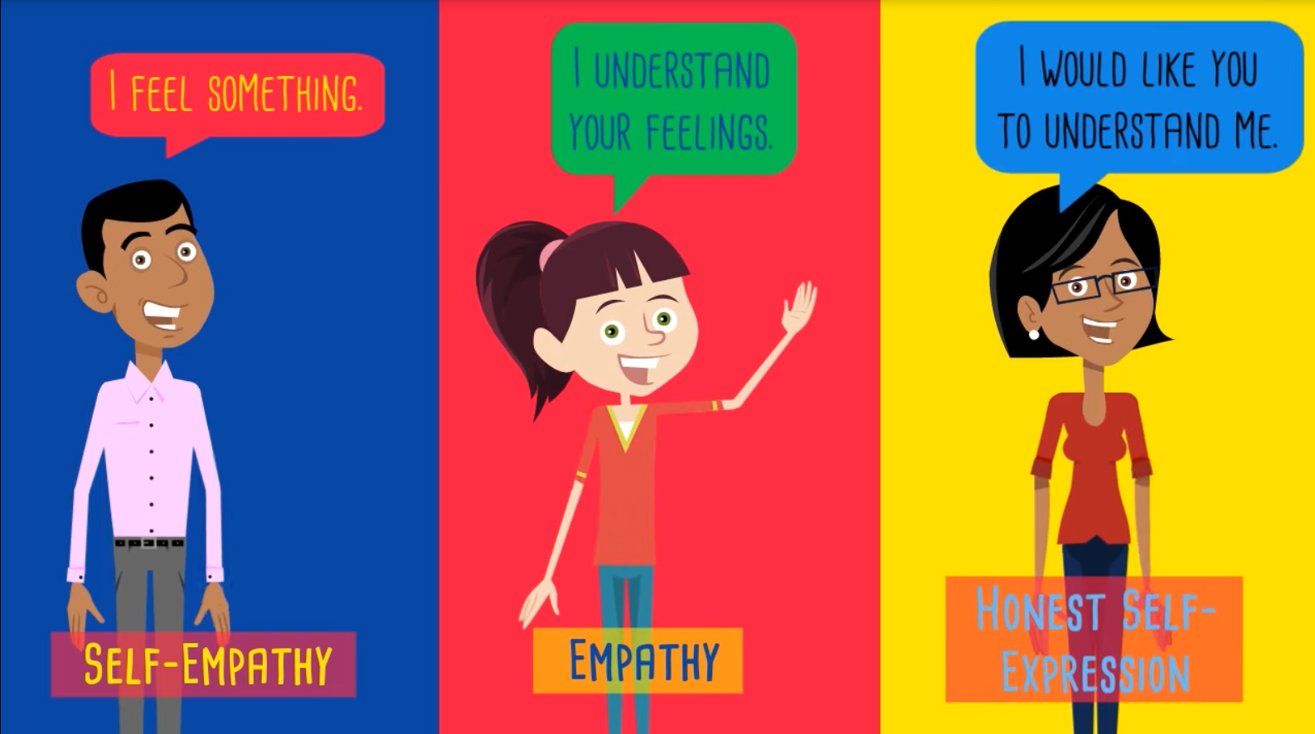
Notes:
NVC focus on 3 aspects of communication:
SELF-EMPATHY: Awareness of your own experience
EMPATHY: Understanding of the other with your heart
HONEST SELF-EXPRESSION: Expression that inspires compassion in others

Slide 16
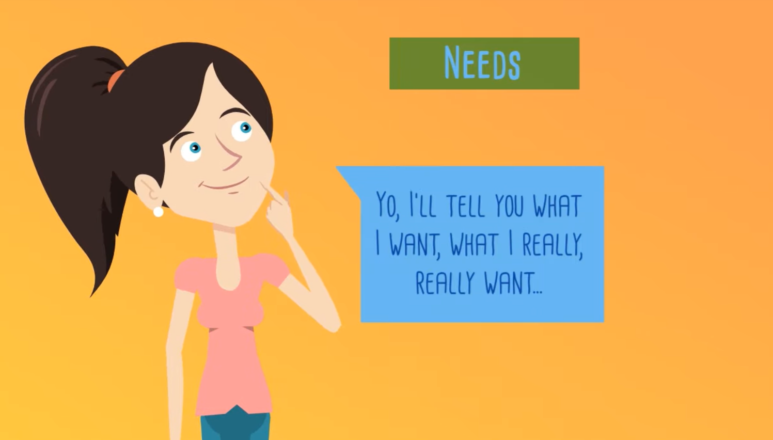
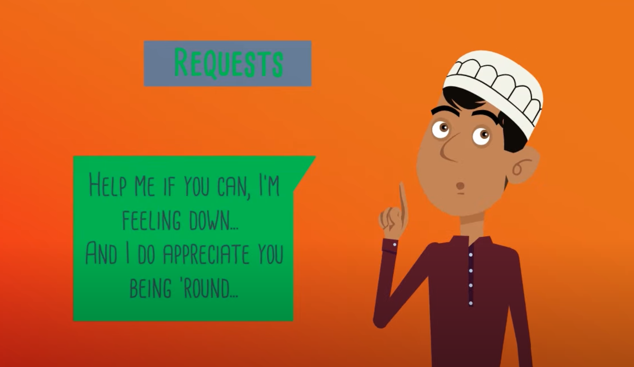
Notes:
NVC Process:
OBSERVATION - Operationalize what you see, hear or touch without any evaluation
FEELINGS - What are your feelings without thoughts or stories added to them
NEEDS – What do you desire without thinking of the strategy for you to do when you get there
REQUESTS – What specific action would you like to ask without demanding it.
Put the pieces together
When you do A “When you are late”
I feel B Because I want C “I feel neglected because I want to use my time well”
I would appreciate it if you would be willing to do D “I would appreciate it if you could let me know when you are running late.
Reminder of AWARENESS first
NVC is a way to have healthy relationships because you are:
CONSCIOUS
PRESENT
IN TUNE

Slide 17
NVC Worksheet
Observe the Facts of the situation.
What is happening without your judgments about it?
Get in touch with your Emotions.
Where are they in your body? State these feelings.
Clarify Your Needs.
Become clear about what you value. What are your priorities right now?
Make a Request.
Must be realistic and doable, appeals.
Notes:
Practice clearning expressing yourself without blaming or critizing using NVC Worksheet
FACTS What happened without judgement
EMOTIONS/FEELINGS Where are they in your body – awareness – feelings inventory (when needs are satisfied /not satisfied)
NEEDS What are your priorities (needs inventory)
REQUEST – realistic and doeable
Write your NVC Statements in the chat box.

Slide 18
THANK YOU for Celebrating HSPBIS Implementation

Slide 19
KEYNOTE
Susan Barrett Director Center for Social Behavior Supports, Old Dominion University
Integrating a Trauma-Informed Approach within the HS-PBIS Framework
ADMINSTRATOR and SUPPORT PERSONNEL Stand
Jacob Olsen, Ph.D., Assistant Professor, Counseling Program, California State University Long Beach Providing Trauma Informed Supports through a PBIS Framework
TEACHER Strand
Ami Flammini, LCSW, Technical Assistance & Training Director, Midwest PBIS Network
PBIS Trauma-Informed Alignment for High School Classrooms
STUDENT PLUS ADULT ALLY Strand
Patti Hershfeldt, Ed.D, Co-director, Center for Social Behavior Support, Old Dominion University
Supporting Wellness for ALL Students: Examples from the Field
EDUCATOR WELLNESS Plenary
Cristy Clouse and Henri Maddocks, CalTAC-PBIS, Inc.
Cultivating Your Well-Being: Four Pillars of a Healthy Mind Practice Activities

